Slide 1
Textures Part One: terms, concepts, algorithms
CSCI 440

Slide 2
Context
So far we have learned how to
build shapes
create movement
change views
add simple lights
But, our objects still look very cartoonish.
mostly because they lack detail
For more detail, we need to deal with individual pixels, not just big shapes.
so, we move from the vertex shader to the fragment shader.

Slide 3
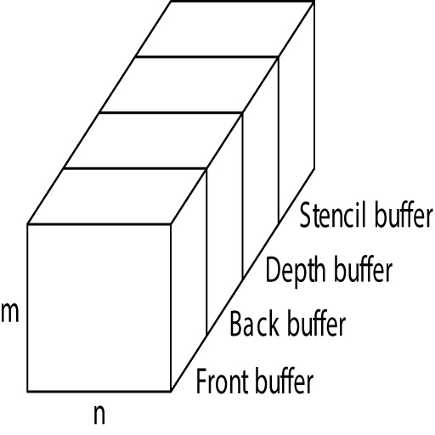
Buffers
All four are the "frame buffer".
Front and Back are typically 32 bits per pixel
8 bits for each of RGBA
Programmer usually sees the frame buffer as a black box.
reading frame data is possible, but contrary to the pipeline

Slide 4
Memory
CPU memory
GPU memory
frame buffer
arrays of vertex data, normals data, …
Texture memory
stored on GPU

Slide 5
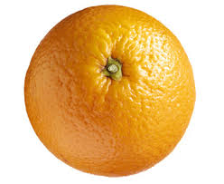

Mapping
To create a realistic shape, we either need to
A - use a lot of surfaces
B - make the few surfaces look complex
B is more manageable
done in pipeline as part of fragment processing
texture mapping is part of WebGL
standard hardware for most GPUs
bump mapping can be done in the fragment shader

Slide 6
Mapping techniques
Texture Mapping
an image influences the color of pixels
image could be a photo, generated pattern, …
Environment Mapping
used to simulate very shiny surfaces
texture of another nearby surface is merged with the shiny surface
Bump Maps
create irregular surfaces by altering the normal vectors

Slide 7
Terminology
texel
a texture pixel
texture coordinates
[ s, t ]
range from 0.0 to 1.0
texture map
how points on the surface map to points on the texture

Slide 8
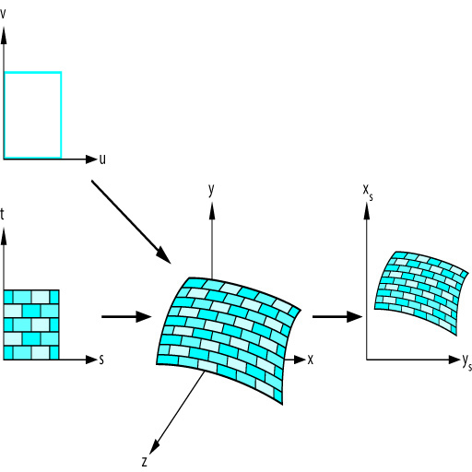
Mapping
Angel figure 7.5

Slide 9
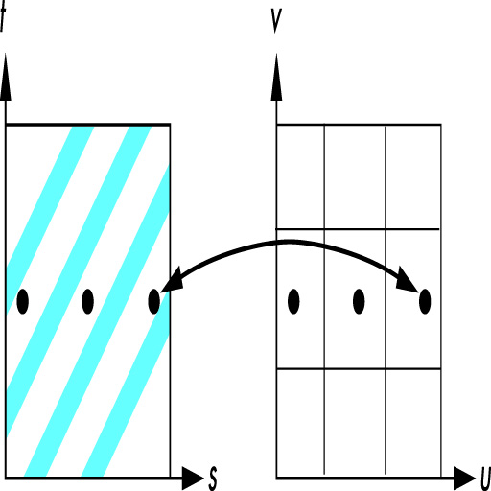
the Aliasing problem
Angel figure 7.7

Slide 10
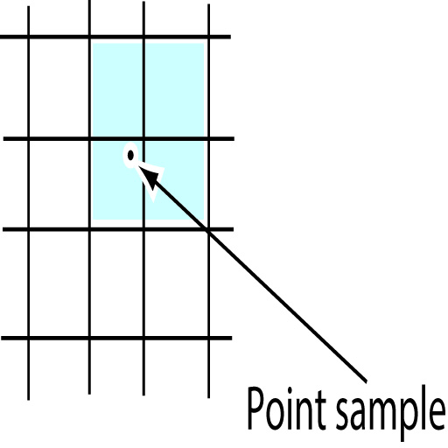
Sampling Options
Point Sampling
use the texel closest to the center of the pixel
simple (fast), but creates visible aliasing errors
Linear Filtering
weighted average of neighboring texels
Angel figure 7.16

Slide 11
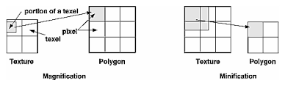
Min and Mag
The size of the pixel may be larger or smaller than the texel. So, we may need to magnify or minify.
gl.texParameter(gl.TEXTURE_2D,
gl.TEXTURE_MAG_FILTER, gl.NEAREST);
gl.texParameter(gl.TEXTURE_2D,
gl.TEXTURE_MIN_FILTER, gl.LINEAR);

Slide 12
MipMaps
Suppose we have a small distant object textured with a big image. Mapping that huge picture to a tiny surface will look terrible and take a lot of GPU time.
Suppose the opposite. We have a small texture, but the surface has gotten really close, so we see lots of detail.
We can use levels of textures.
64x64, 32x32, … 1x1
That is called a Mipmap.

Slide 13
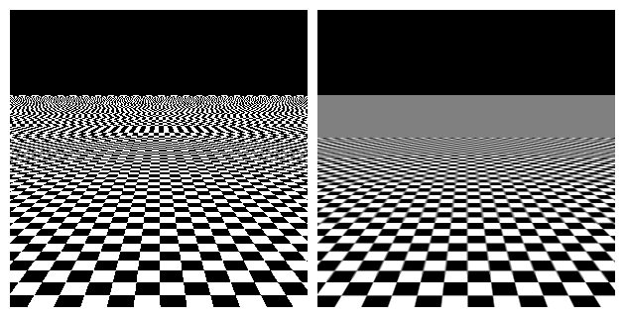
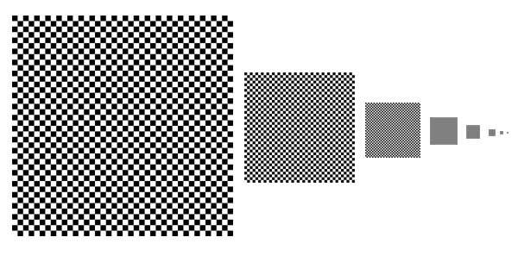
Without and with mipmaps
wikipedia.org

Slide 14
Mipmap options
Nearest_Mipmap_Nearest
point sample with closest mipmap
Nearest_Mipmap_Linear
linear filtering within the closest mipmap
Linear_Mipmap_Nearest
point sampling using filtering between mipmaps
Linear_Mipmap_Linear
linear filtering of linear filtered mipmaps

Slide 15
Next time
Texture code

